Slide 1
Solve CSPs using Local Search

Slide 2
Local search for CSPs – Ideas
Idea:
For example,
➔
➔

Slide 3
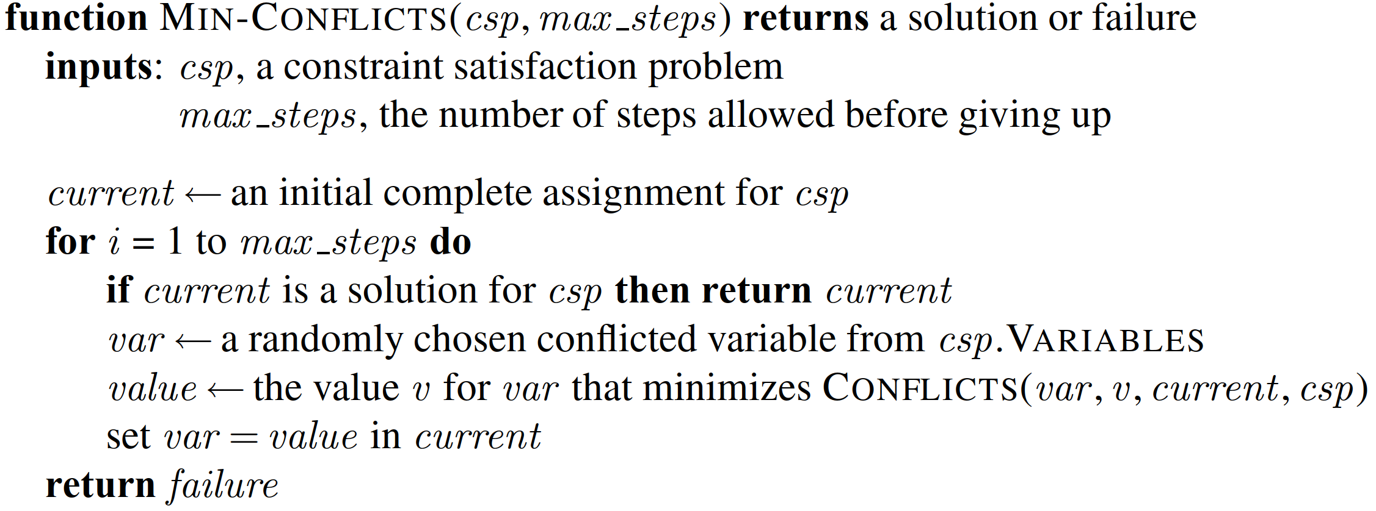
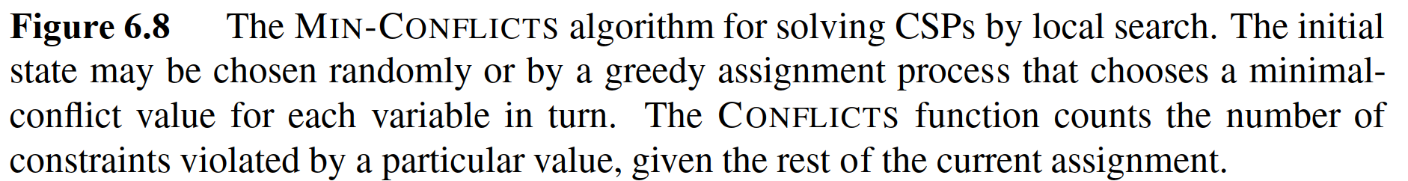
Min-conflict algorithm
Source: (Russell, 2016)

Slide 4
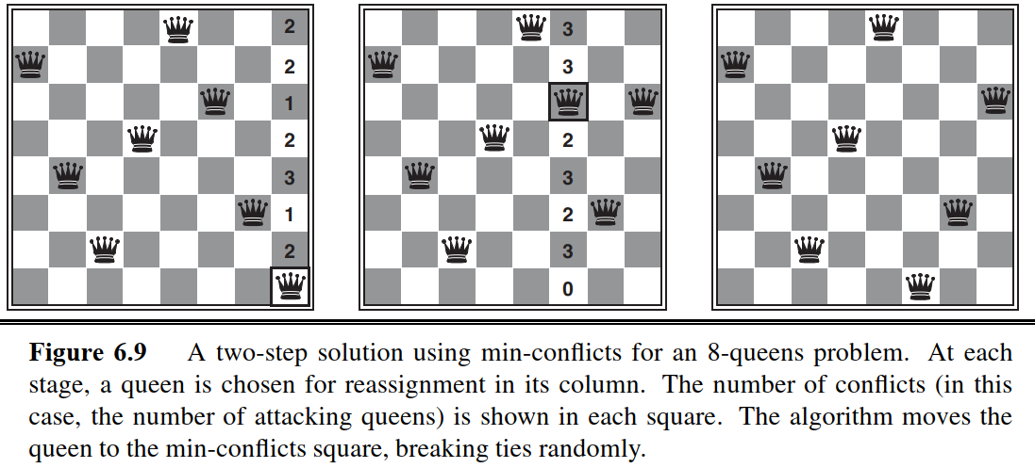
Demo
Source: (Russell, 2016)

Slide 5
Min-conﬂicts is surprisingly effective for many CSPs.
It solves even the million-queens problem in
It has been used to schedule observations for the Hubble Space Telescope, reducing the time taken to schedule a week of observations from

Slide 6
Solve CSPs using Constraint Graphs

Slide 7
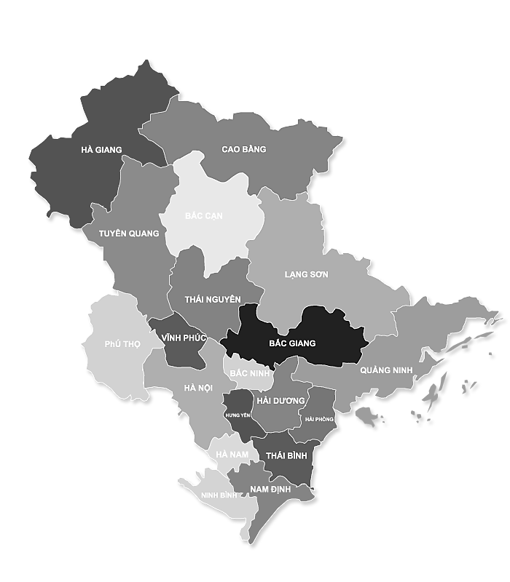















Constraint graph
Nodes:
Links:

Slide 8


















Tree-structured CSP
A CSP has a constraint graph which is a tree:
Can be solved in
Main steps to solve a tree-structed CSP:
1. Pick a variable to be the root. Sort variables such that each variable appears after its parent
2. Enforce arc consistency on sorted variables
3. Choose values for variables from consistent domains.

Slide 9
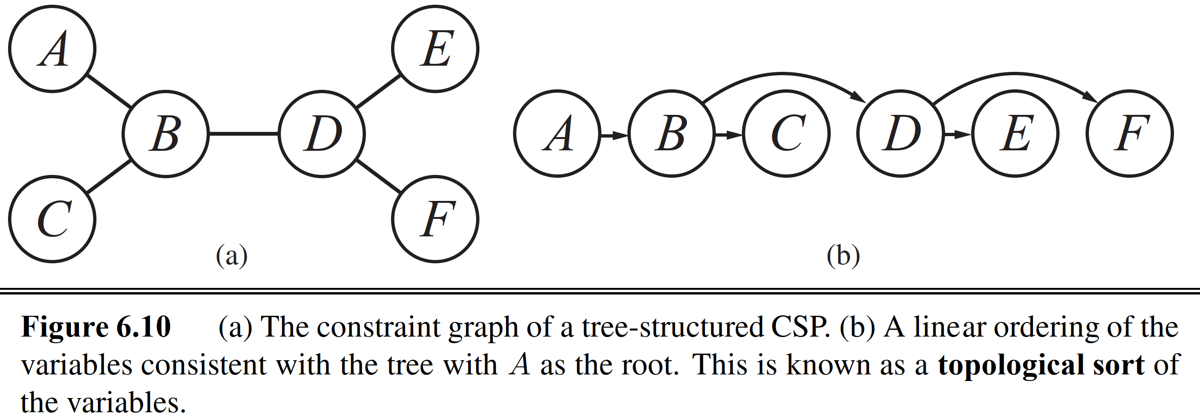

Topological sort
Source: (Russell, 2016)

Slide 10
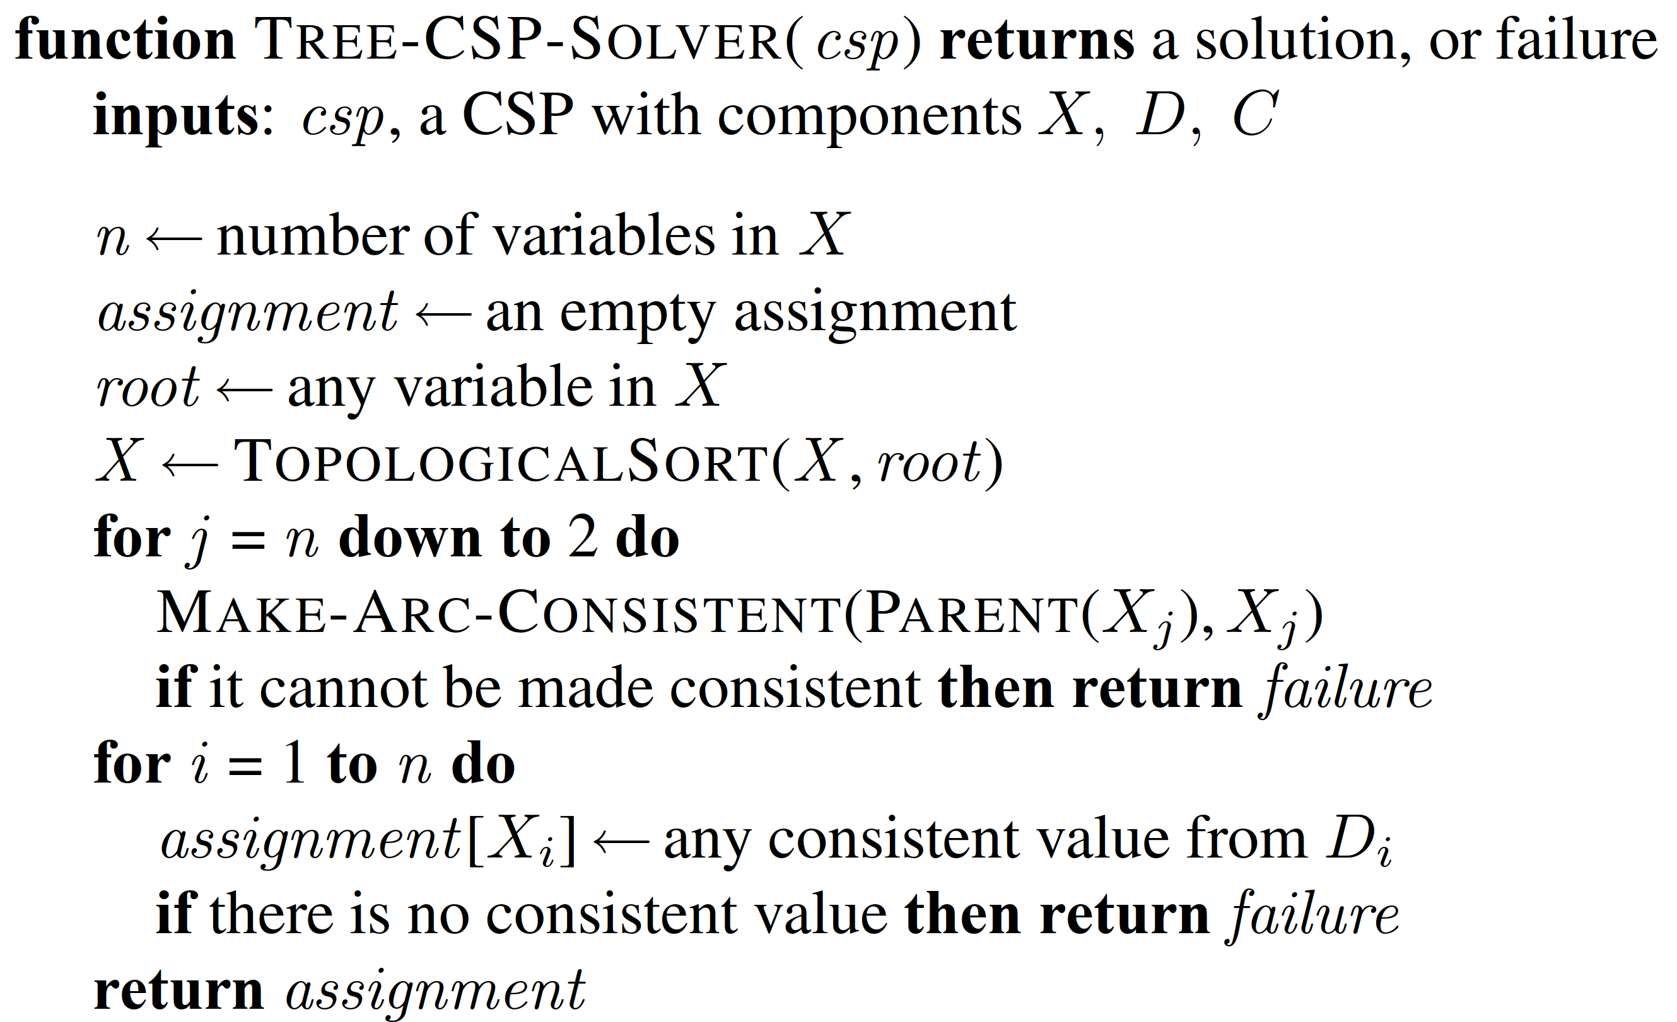







Tree CSP solver
Source: (Russell, 2016)

Slide 11















Tree CSP solver is effective, but what if we don’t have trees
To turn a graph into a tree:

Slide 12
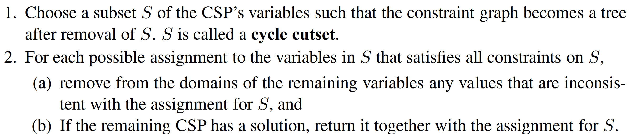







Removing nodes to turn a graph into a tree
Source: (Russell, 2016)

Slide 13
Demo
Turn the graph to a tree by removing nodes {HN, BN}

Slide 14
















Demo
Use tree CSP solver to solve the subproblems

Slide 15



